Slide 1
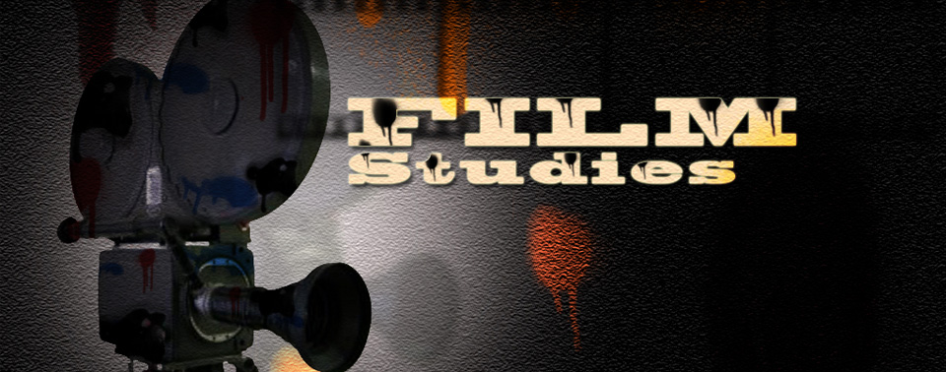

Slide 2
What is a Blockbuster?
What is Mise en scene?
What is Montage?
Discover the answers to these questions and others in a broad introduction to the study of cinema..

Slide 3



Slide 4
Module 1:- Introduction to the basic terminology of filmmaking.
Module 2:- Introduction to film genres.
Module 3:- Introduction to major movements and theories.
Module 4:- Selected film text.

Slide 5
CASE STUDIES OF CLASSIC CINEMA

Slide 6
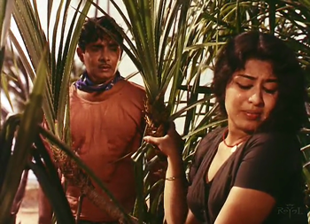
CHEMEEN

Slide 7
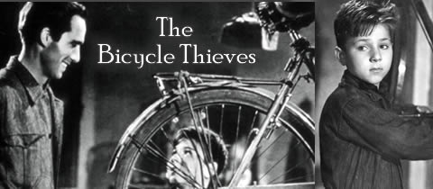

Slide 8
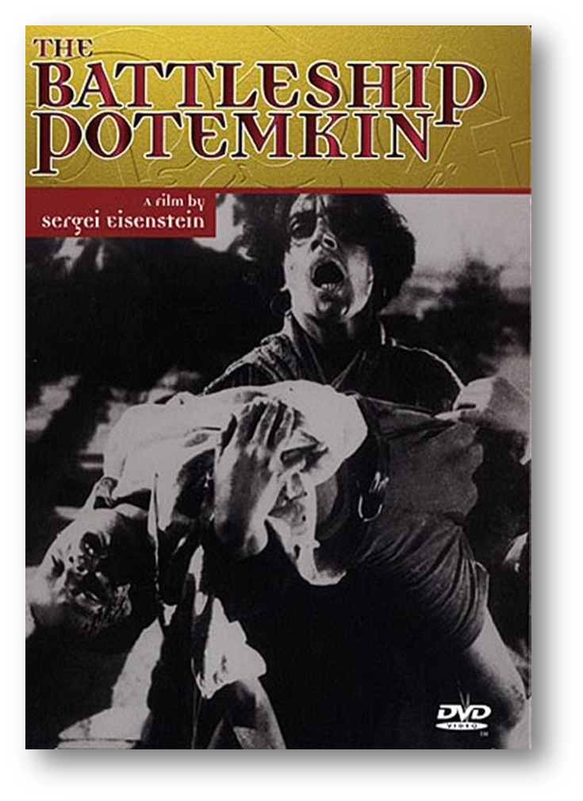

Slide 9


Slide 10


Slide 11


Slide 12
Film studies offer the chance to gain hands-on experience of film-making and also touch on topics such as film history, theory and criticism.
The more you learn cinema; the more you can enjoy and understand it.
It would be a turning point if you admire film industry.

Slide 13
